Slide 1
Linear Regression
Applications of Linear Regression in Python
Let’s look at a few applications of linear regression.
Economic Growth
Linear regression is used to determine the economic growth of a country or a state in the upcoming quarter. It can also be used to predict a nation’s gross domestic product (GDP).
Product Price
Linear regression can be used to predict what the price of a product will be in the future, whether prices will go up or down.
Housing Sales
Linear regression can be used to estimate the number of houses a builder will sell in the coming months and at what price.
Score Predictions
Linear regression can be used to predict the number of runs a baseball player will score in upcoming games based on previous performance.

Slide 2
Understanding Linear Regression in Python
Linear regression is a statistical model used to predict the relationship between independent and dependent variables by examining two factors:
Which variables, in particular, are significant predictors of the outcome variable?
How significant is the regression line in terms of making predictions with the highest possible accuracy?
To understand the terms “dependent” and “independent variable,” let’s take a real-world example. Imagine that we want to predict future crop yields based on the amount of rainfall, using data regarding past crops and rainfall amounts.
Independent Variable
The value of an independent variable does not change based on the effects of other variables. An independent variable is used to manipulate the dependent variable. It is often denoted by an “x.” In our example, the rainfall is the independent variable because we can’t control the rain, but the rain controls the crop—the independent variable controls the dependent variable.
Dependent Variable
The value of this variable changes when there is any change in the values of the independent variables, as mentioned before. It is often denoted by a “y.” In our example, the crop yield is the dependent variable, and it is dependent on the amount of rainfall.

Slide 3
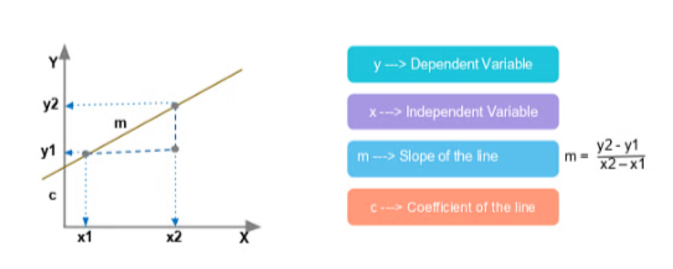
Regression Equation
The simplest linear regression equation with one dependent variable and one independent variable is:
y = m*x + c
Look at this graphic:
We have plotted two points, (x1,y1) and (x2,y2). Let’s discuss the example of crop yield used earlier in the article, and plot the crop yield based on the amount of rainfall. Here, rainfall is the independent variable and crop yield is the dependent variable.

Slide 4
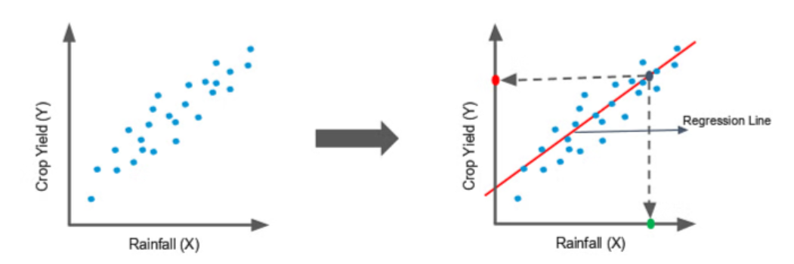
.
Consider these graphs:
Here, we’ve drawn a line through the middle of the data. The red point on the y-axis is the crop yield you can expect for the amount of rainfall (x) represented by the green dot.
If we have an idea about the amount of rainfall for a year, then we can predict how plentiful our crop will be.

Slide 5
Reasoning Behind the Regression Line
Let’s consider a sample data set with five rows and find out how to draw the regression line. We’ll take two sets of data in which x is the independent variable and y is the dependent variable:
x | y
1 | 2
2 | 4
3 | 5
4 | 4
5 | 5
:

Slide 6
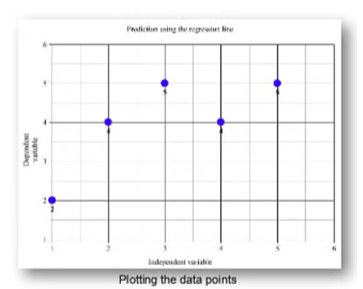
.
This is a graph with the data plotted:

Slide 7
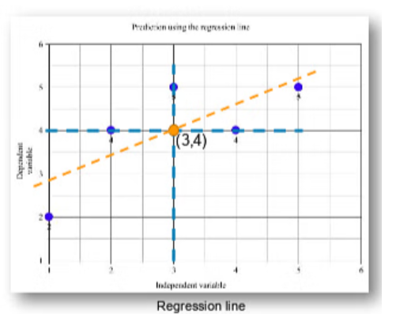
.
Next, we calculate the means, or average values, of x and y. The average of the x values is 3, and the average of the y values is 4.
We plot both means on the graph to get the regression line.

Slide 8
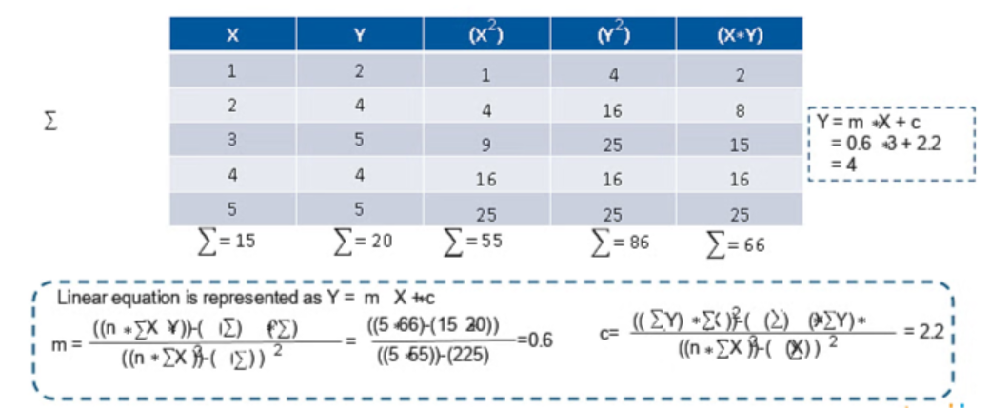
.
Now we’ll discuss the regression line equation. The computation is:

Slide 9
.
We have calculated the values for x2, y2 and x*y to calculate the slope and intercept of the line. The calculated values are:
m = 0.6
c = 2.2
The linear equation is:
y = m*x + c
Let’s find out the predicted values of y for corresponding values of x using the linear equation in which m = 0.6 and c = 2.2 and plot them.

Slide 10
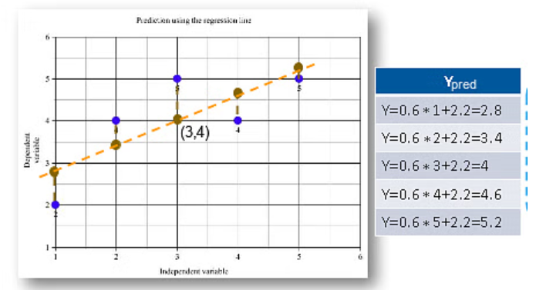
.
Here, the blue points represent the actual y values, and the brown points represent the predicted y values based on the model we created. The distances between the actual and predicted values are known as residuals or errors. The best-fit line should have the lowest sum of squares of these errors, also known as “e square.”

Slide 11
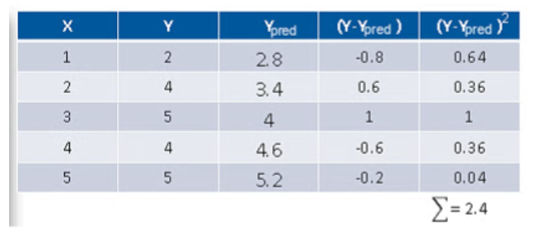
.
.

Slide 12
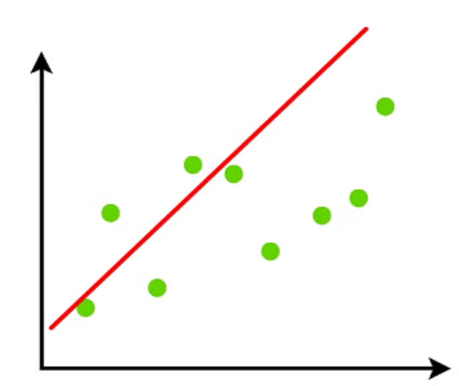
.
You can observe that the sum of squared errors for this regression line is 2.4. We check this error for each line and determine the best-fit line having the lowest e square value. The graphical representation is:
We keep the line moving through the data points to make sure the best-fit line has the least squared distance between the data points and the regression line.
The above example shows the most commonly used formula for minimizing the distance. There are lots of ways to minimize the distance between the line and the data points, such as using the sum of squared errors, the sum of absolute errors and the root mean square error.
So far we have dealt with only two values, x and y. But it’s very rare in the real world to have only have two values when you’re calculating. Let’s talk about what happens when you have multiple inputs.

Slide 13
Multiple Linear Regression
In simple linear regression, we have the equation:
y = m*x + c
For multiple linear regression, we have the equation:
y = m1x1 + m2x2 + m3x3 +........ + c
Here, we have multiple independent variables, x1, x2 and x3, and multiple slopes, m1, m2, m3 and so on.

Slide 14
Regression Evaluation Metrics
Here are some most popular evaluation metrics for regression:
Mean Absolute Error (MAE): The average absolute difference between the predicted and actual values of the target variable.
Mean Squared Error (MSE): The average squared difference between the predicted and actual values of the target variable.
Root Mean Squared Error (RMSE): The square root of the mean squared error.
Huber Loss: A hybrid loss function that transitions from MAE to MSE for larger errors, providing balance between robustness and MSE’s sensitivity to outliers.
Root Mean Square Logarithmic Error
R2 – Score: Higher values indicate better fit, ranging from 0 to 1.

Slide 15
Regression Types
There are two main types of regression:
Simple Regression
Used to predict a continuous dependent variable based on a single independent variable.
Simple linear regression should be used when there is only a single independent variable.
Multiple Regression
Used to predict a continuous dependent variable based on multiple independent variables.
Multiple linear regression should be used when there are multiple independent variables.
NonLinear Regression
Relationship between the dependent variable and independent variable(s) follows a nonlinear pattern.
Provides flexibility in modeling a wide range of functional forms.

Slide 16
Regression Algorithms
There are many different types of regression algorithms, but some of the most common include:
Linear Regression
Linear regression is one of the simplest and most widely used statistical models. This assumes that there is a linear relationship between the independent and dependent variables. This means that the change in the dependent variable is proportional to the change in the independent variables.
Polynomial Regression
Polynomial regression is used to model nonlinear relationships between the dependent variable and the independent variables. It adds polynomial terms to the linear regression model to capture more complex relationships.
Support Vector Regression (SVR)
Support vector regression (SVR) is a type of regression algorithm that is based on the support vector machine (SVM) algorithm. SVM is a type of algorithm that is used for classification tasks, but it can also be used for regression tasks. SVR works by finding a hyperplane that minimizes the sum of the squared residuals between the predicted and actual values.

Slide 17
.
Decision Tree Regression
Decision tree regression is a type of regression algorithm that builds a decision tree to predict the target value. A decision tree is a tree-like structure that consists of nodes and branches. Each node represents a decision, and each branch represents the outcome of that decision. The goal of decision tree regression is to build a tree that can accurately predict the target value for new data points.
Random Forest Regression
Random forest regression is an ensemble method that combines multiple decision trees to predict the target value. Ensemble methods are a type of machine learning algorithm that combines multiple models to improve the performance of the overall model. Random forest regression works by building a large number of decision trees, each of which is trained on a different subset of the training data. The final prediction is made by averaging the predictions of all of the trees.

Slide 18
Regularized Linear Regression Techniques
Ridge Regression
Ridge regression is a type of linear regression that is used to prevent overfitting. Overfitting occurs when the model learns the training data too well and is unable to generalize to new data.
Lasso regression
Lasso regression is another type of linear regression that is used to prevent overfitting. It does this by adding a penalty term to the loss function that forces the model to use some weights and to set others to zero.

Slide 19
Characteristics of Regression
Here are the characteristics of the regression:
Continuous Target Variable: Regression deals with predicting continuous target variables that represent numerical values. Examples include predicting house prices, forecasting sales figures, or estimating patient recovery times.
Error Measurement: Regression models are evaluated based on their ability to minimize the error between the predicted and actual values of the target variable. Common error metrics include mean absolute error (MAE), mean squared error (MSE), and root mean squared error (RMSE).
Model Complexity: Regression models range from simple linear models to more complex nonlinear models. The choice of model complexity depends on the complexity of the relationship between the input features and the target variable.
Overfitting and Underfitting: Regression models are susceptible to overfitting and underfitting.
Interpretability: The interpretability of regression models varies depending on the algorithm used. Simple linear models are highly interpretable, while more complex models may be more difficult to interpret.

Slide 20
An Introduction to Logistic Regression
Logistic regression is a statistical method that is used for building machine learning models where the dependent variable is dichotomous: i.e. binary. Logistic regression is used to describe data and the relationship between one dependent variable and one or more independent variables. The independent variables can be nominal, ordinal, or of interval type.
The name “logistic regression” is derived from the concept of the logistic function that it uses. The logistic function is also known as the sigmoid function. The value of this logistic function lies between zero and one.

Slide 21
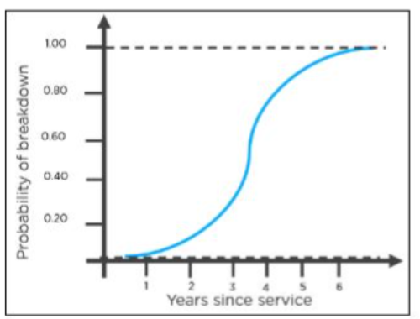
.
The following is an example of a logistic function we can use to find the probability of a vehicle breaking down, depending on how many years it has been since it was serviced last.

Slide 22
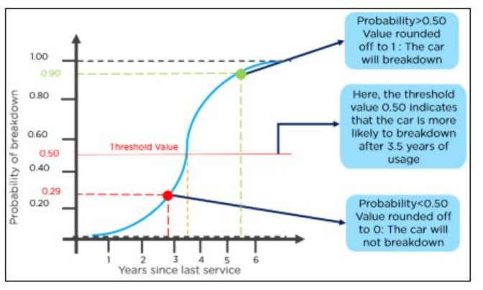
.
Here is how you can interpret the results from the graph to decide
whether the vehicle will break down or not.

Slide 23
Advantages of the Logistic Regression Algorithm
Logistic regression performs better when the data is linearly separable
It does not require too many computational resources as it’s highly interpretable
There is no problem scaling the input features—It does not require tuning
It is easy to implement and train a model using logistic regression
It gives a measure of how relevant a predictor (coefficient size) is, and its direction of association (positive or negative)

Slide 24
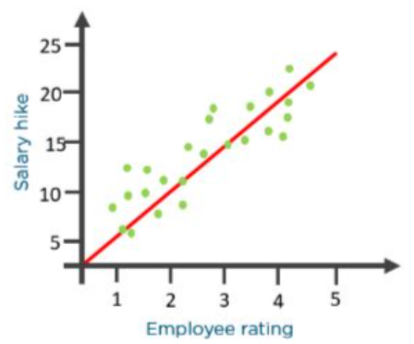
How Does the Logistic Regression Algorithm Work?
Consider the following example: An organization wants to determine an employee’s salary increase based on their performance.
For this purpose, a linear regression algorithm will help them decide. Plotting a regression line by considering the employee’s performance as the independent variable, and the salary increase as the dependent variable will make their task easier.

Slide 25
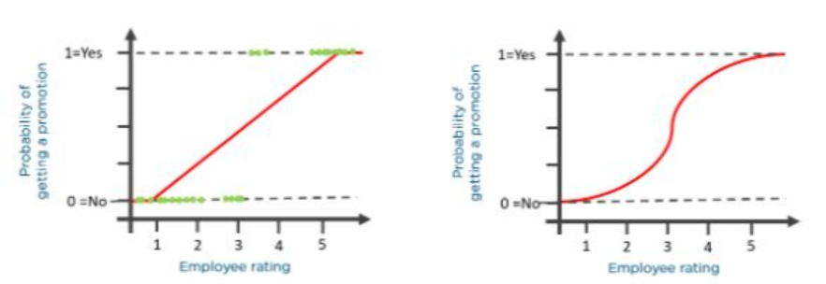
.
Now, what if the organization wants to know whether an employee would get a promotion or not based on their performance? The above linear graph won’t be suitable in this case. As such, we clip the line at zero and one, and convert it into a sigmoid curve (S curve).

Slide 26
.
Based on the threshold values, the organization can decide whether an employee will get a salary increase or not.
To understand logistic regression, let’s go over the odds of success.
Odds (𝜃) = Probability of an event happening / Probability of an event not happening
𝜃 = p / 1 - p
The values of odds range from zero to ∞ and the values of probability lies between zero and one.
Consider the equation of a straight line:
𝑦 = 𝛽0 + 𝛽1* 𝑥

Slide 27
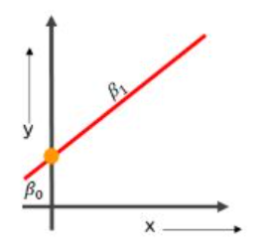

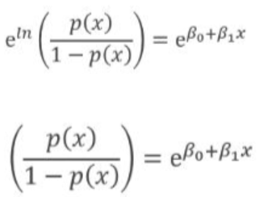
.
Here, 𝛽0 is the y-intercept
𝛽1 is the slope of the line
x is the value of the x coordinate
y is the value of the prediction
Now to predict the odds of success, we use the following formula:
Exponentiating both the sides, we have:

Slide 28


.
Let Y =
Then p(x) / 1 - p(x) = Y
p(x) = Y(1 - p(x))
p(x) = Y - Y(p(x))
p(x) + Y(p(x)) = Y
p(x)(1+Y) = Y
p(x) = Y / 1+Y

Slide 29

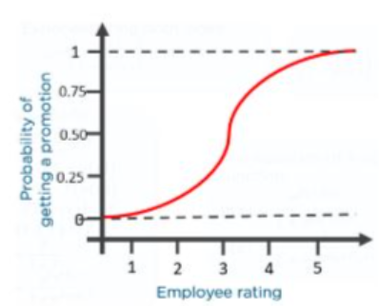
.
The equation of the sigmoid function is:
The sigmoid curve obtained from the above equation is as follows:

Slide 30
Linear Regression vs. Logistic Regression
N
Linear Regression | Logistic Regression
Used to solve regression problems | Used to solve classification problems
The response variables are continuous in nature | The response variable is categorical in nature
It helps estimate the dependent variable when there is a change in the independent variable | It helps to calculate the possibility of a particular event taking place
It is a straight line | It is an S-curve (S = Sigmoid)

Slide 31
Applications of Logistic Regression
Using the logistic regression algorithm, banks can predict whether a customer would default on loans or not
To predict the weather conditions of a certain place (sunny, windy, rainy, humid, etc.)
Ecommerce companies can identify buyers if they are likely to purchase a certain product
Companies can predict whether they will gain or lose money in the next quarter, year, or month based on their current performance
To classify objects based on their features and attributes

Slide 32
Assumption in a Logistic Regression Algorithm
In a binary logistic regression, the dependent variable must be binary
For a binary regression, the factor level one of the dependent variables should represent the desired outcome
Only meaningful variables should be included
The independent variables should be independent of each other. This means the model should have little or no multicollinearity
The independent variables are linearly related to the log odds
Logistic regression requires quite large sample sizes

